Slide 1
The Impact of Activity Funding on Students Pursuing Higher Education
Bryon Hobbs, Brenda Johansen, Lalita Ponnapalli, Staci Stapleton

Slide 2
The Importance of Continued Education
Interest in the development and continued education of children (2 year programs through PHD)
Provide correlations and statistical backing to the importance of activity funding
School districts can use this analysis to find budgetary allocation that promotes success in students further education
Parents can use this analysis to influence their choice in child placement

Slide 3

Data Sources
Wisconsin Department of Public Instruction
District Report Cards, Comparative District Costs,
Comparative District Revenue District Post-Secondary Enrollment Statistics
https://dpi.wi.gov/

Slide 4
The Purpose of Analysis
Does the amount of budgetary funding for high school extracurricular activities have an impact on whether students attend post secondary educational programs?

Slide 5
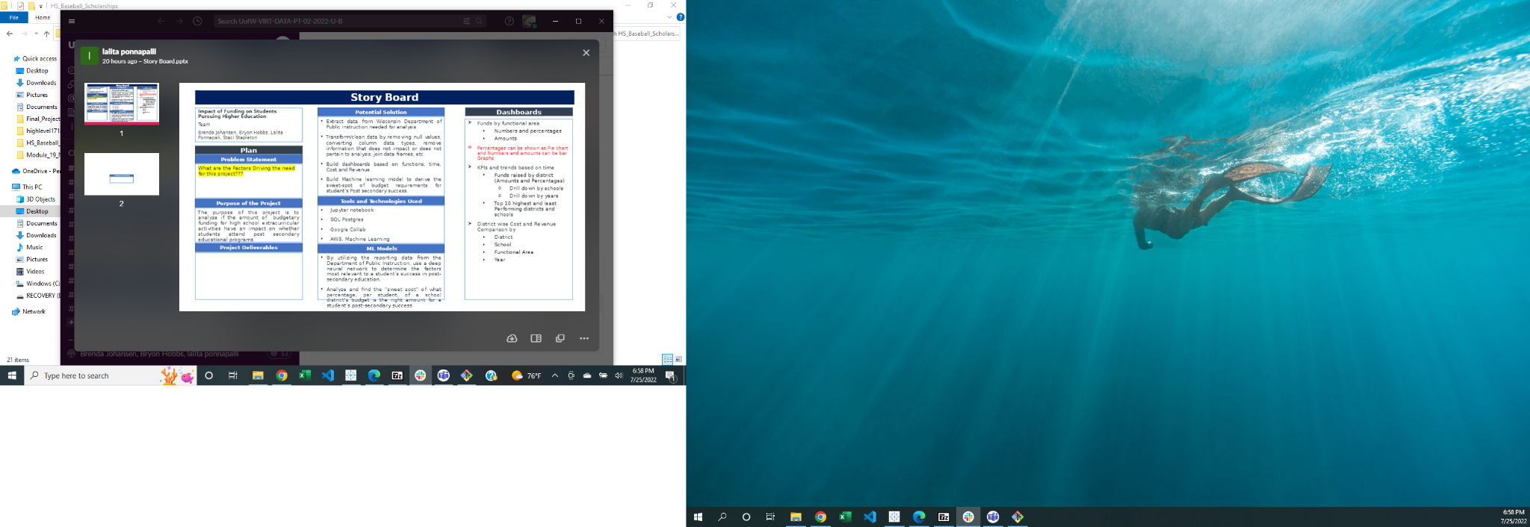

Slide 6
Data Exploration
Extract data from Wisconsin Department of Public Instruction needed for analysis
Transform/clean data by removing null values, converting column data types, remove information that does not impact or does not pertain to analysis, join dataframes, etc

Slide 7
Data Analysis through Machine Learning
By taking in data from multiple reports from the Department of Public Instruction, I will use a deep neural network to determine what factors are most relevant to a student’s success in post-secondary education. Through the analysis, we look to find the “sweet spot” of what percentage, per student, of a school district’s budget is the right amount for a student’s post-secondary success.

Slide 8
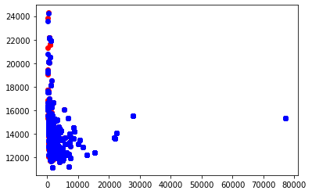
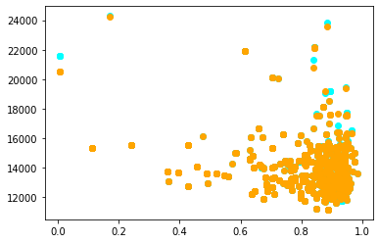
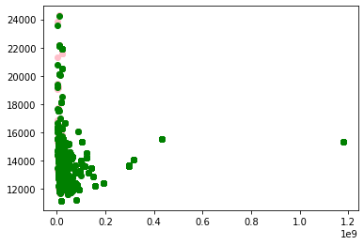
Machine learning Scatter Plot
Total Members % White Revenue Total

Slide 9





Technologies, Languages, Tools, and Algorithms Used
Python
Jupyter Notebook, Google Colab, SQL Postgres
Tableau
Machine Learning

Slide 10
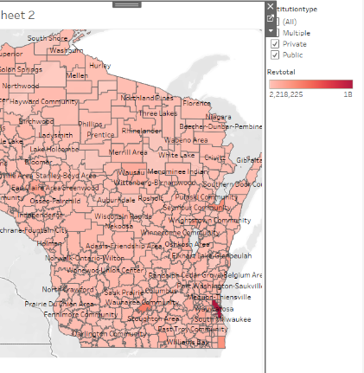
Interactive Map of districts and Funding(color) and filters

Slide 11
Top 10 and lowest 10 ranked districts based on activity funding(table)

